Slide 1
Cricket Match
Outcome Predictor
Machine Learning Project — CSE
NAME: RISHITH KULKARNI HTNO: 2403A51188 BATCH: B09 CSE

Slide 2
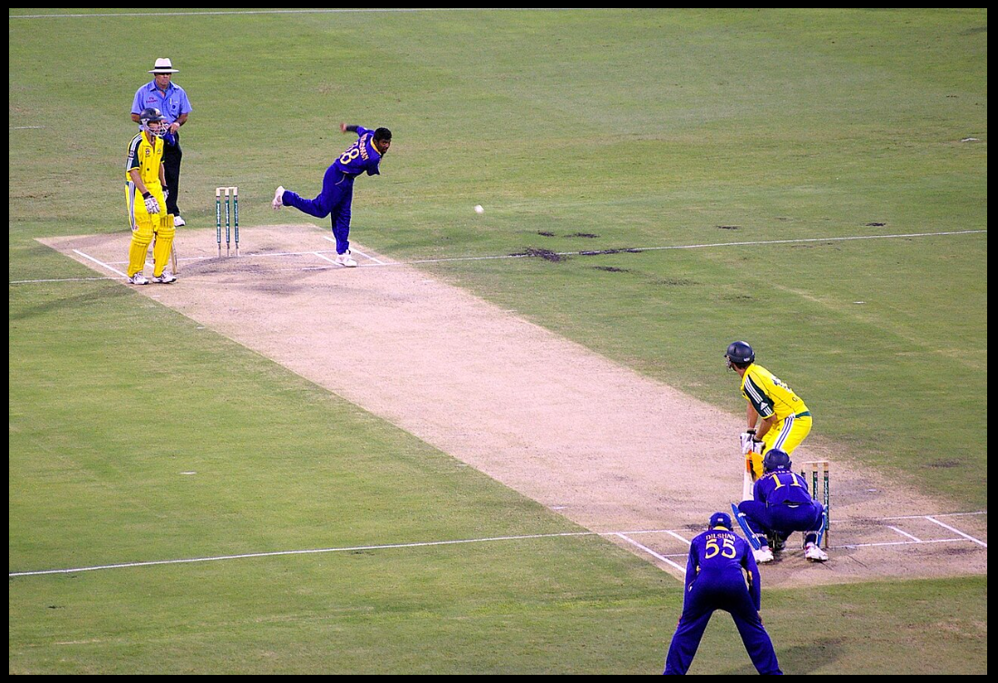
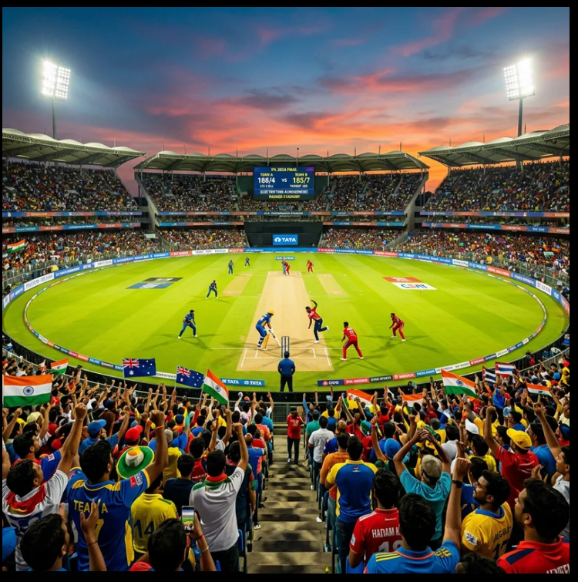
Problem Statement
To predict the winner of a cricket match using machine learning techniques based on historical data and match-related features.
9,000 Matches
Random Forest

Slide 3
Project Introduction
Cricket is one of the most popular sports in the world, with millions of fans eager to predict match outcomes. This project leverages Machine Learning to predict which team wins a cricket match based on historical data.
🏏
🤖
🌐
9,000 Matches
Random Forest
Live Web App
Analyzed across IPL, ODIs, T20s & Tests
We used a Random Forest model, which is a machine learning algorithm.
We also created a website where users can enter match details and get predictions.

Slide 4
Dataset & Methodology
📦 Dataset
🔢 Feature Engineering
9,000 JSON match files
IPL, ODIs, T20s, Test matches
Extracted: Teams, Venue, Toss, Winner
We removed matches where there was no result.
Built binary Result column (1=Team1 wins)
Team1_Strength
This shows how strong Team 1 is based on past wins.
Team2_Strength
This shows how strong Team 1 is based on past wins.
Strength_Diff
This is the difference between both teams’ strength.
TossWinMatchWin
Did toss winner win the match?

Slide 5
Data processing
Algorithm
Random Forest Classifier
63.6%
Trees
500 estimators
Split
80% train / 20% test
Accuracy
Random State
42
Sample Prediction
Win Prob: 85.02% / 14.98%
Feature Importance (from model)
48%
28%
19%
5%
Strength
Diff
Team1
Strength
Team2
Strength
TossWinMatchWin

Slide 6
Web Application
Inputs of Live ML website
Team Selection
Venue & Toss Input
01
02
Choose Team 1 and Team 2 from dropdown menus
Enter match venue and toss outcome
Instant Prediction
Deployed Online
03
04
Model predicts winner with win probability
Accessible from any device via browser

Slide 7
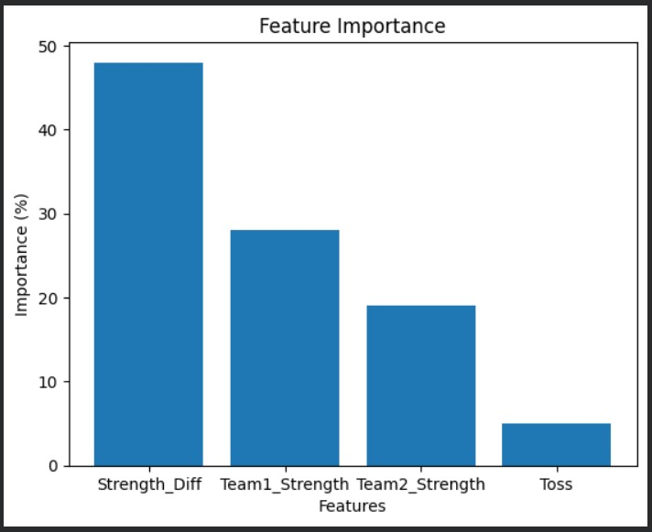
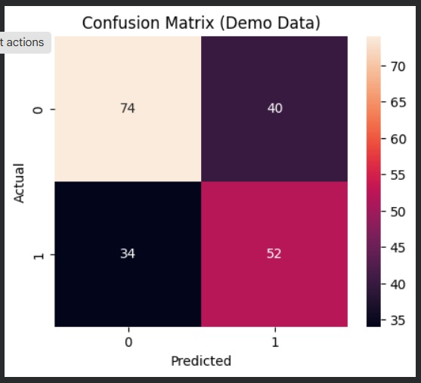
Figures/Plots Showing Results
📈 Feature Importance Graph
📊 Confusion Matrix
Rishith Kulkarni | HTNO: 2403A51188 | Batch 09 CSE

Slide 8
Conclusion & Future Scope
✅ Conclusions
🚀 Future Scope
Our model is able to predict match results with around 63% accuracy
We found that team strength difference is the most important factor.
Toss result has very less impact on the final result.
We also created a live website where users can get predictions.
We also created a live website where users can get predictions.
We can add player details like batting and bowling performance.
We can add player details like batting and bowling performance.
We can also use live match data for real-time prediction.
Rishith Kulkarni | HTNO: 2403A51188 | Batch 09 CSE

Slide 9
Github Repository : https://github.com/rishith3110/cricket-match-outcome-predictor
Thank you !

